Slide 1
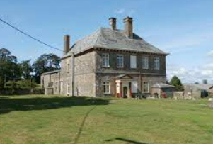
GREAT POTHERIDGE HOUSE
Monday 25th March
to Thursday 28th March 2024
Near Okehampton in North Devon
Roselands have been visiting for many years - it’s like an extension of our family - we like to think of it abit like a holiday home! Safe, familiar, a break in routine but ALOT of fun!

Slide 2
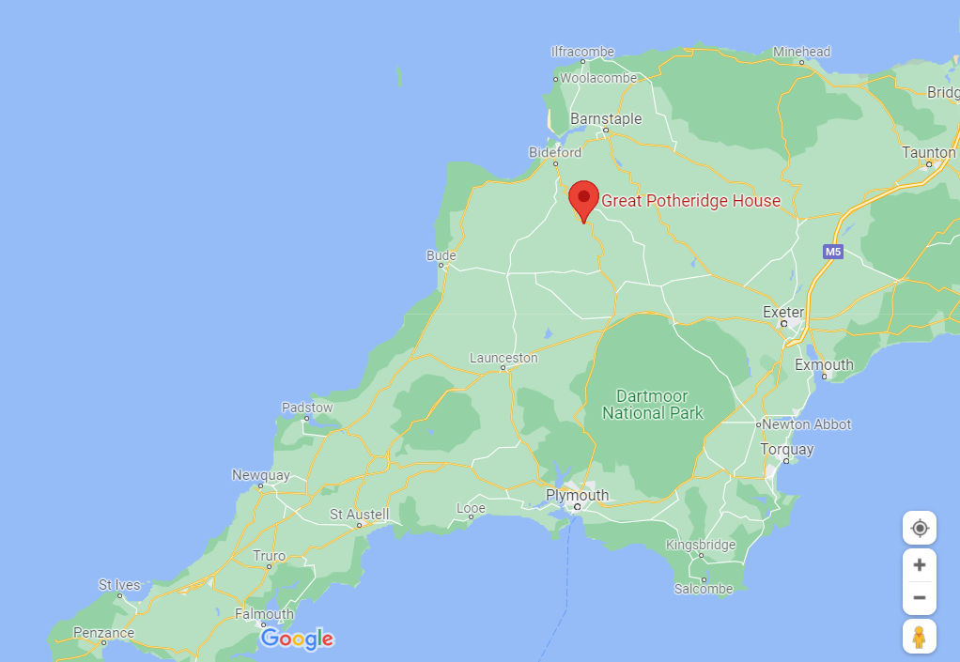
1 hour 45 minutes away
Travel there and back by coach.
We often stop for a day of activities on the way - climbing, scrambling and general fun before we even get there!

Slide 3
Great Potheridge House
Accommodation in main house & Barn complex
90 beds in 9 rooms & 5 staff rooms
Oak Panelled dining room
Walled front garden
Not many neighbours for miles
Great Food – can cater for all allergies/dietary requirement.
Sole occupancy – just Roselands School

Slide 4
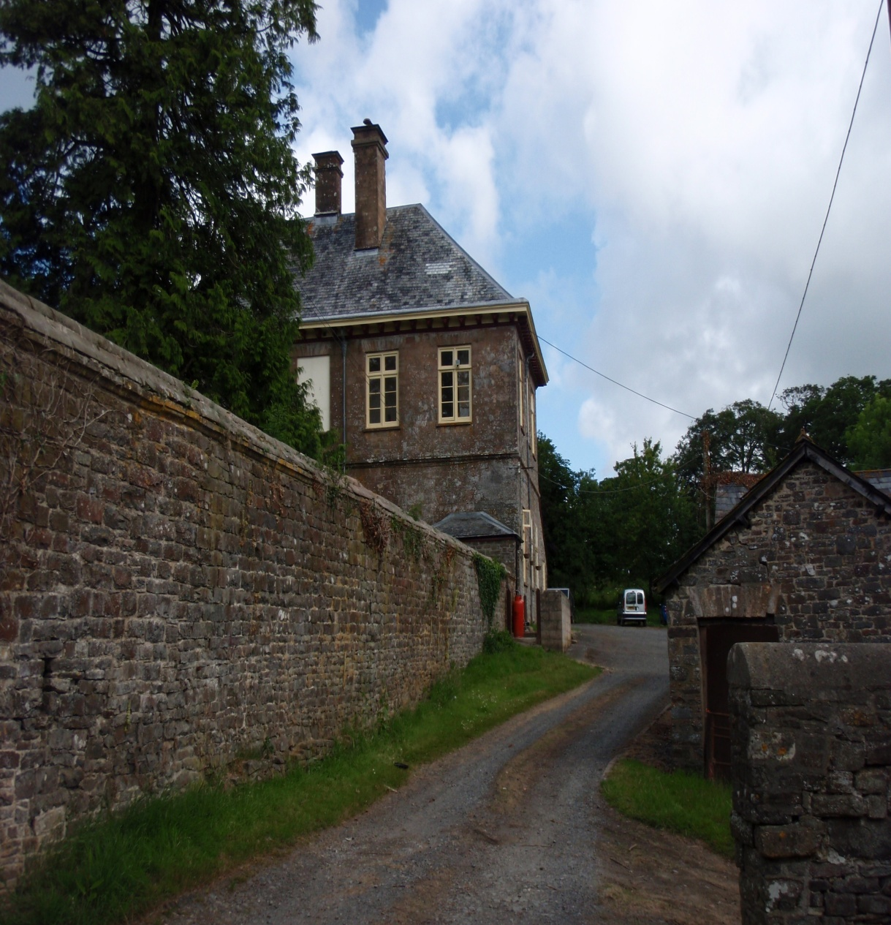
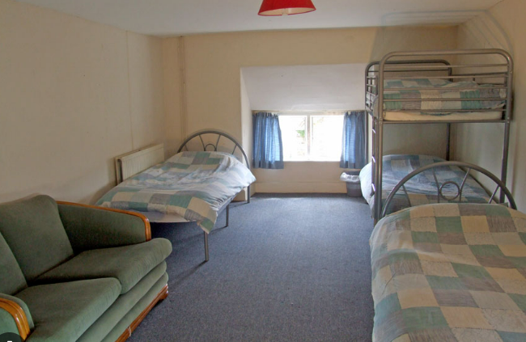

Slide 5
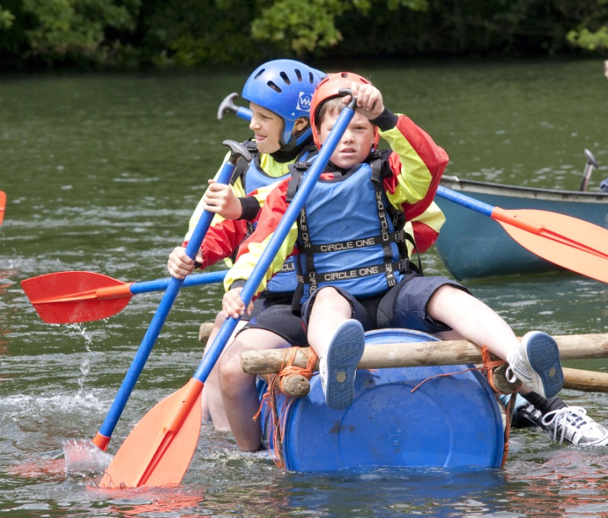
ENCOMPASS TRAINING
Provide a real outdoor education experience
Experienced staffing
Robust safety standards
Attention to your school – sole occupancy

Slide 6
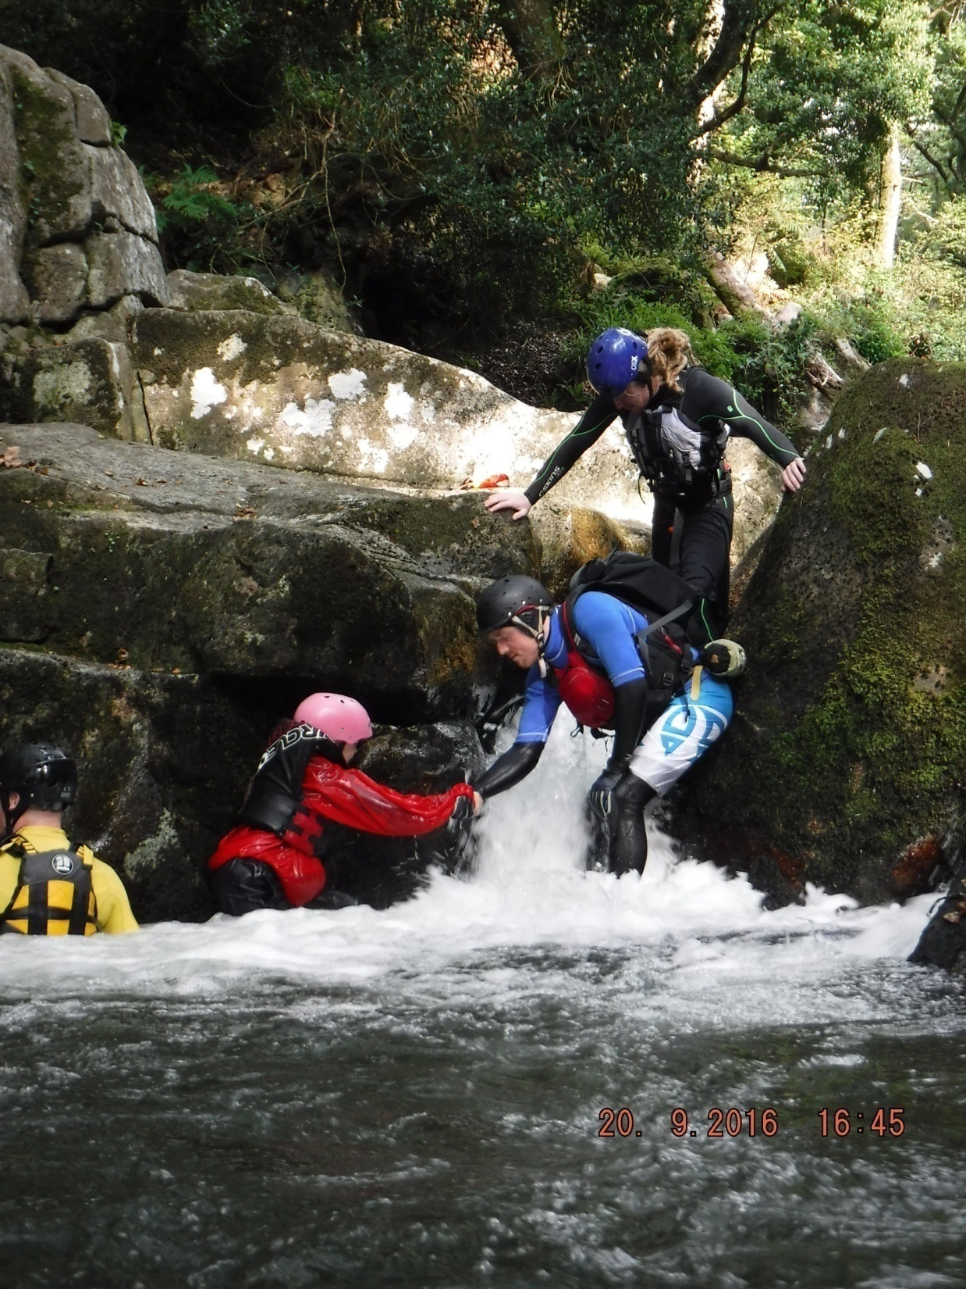
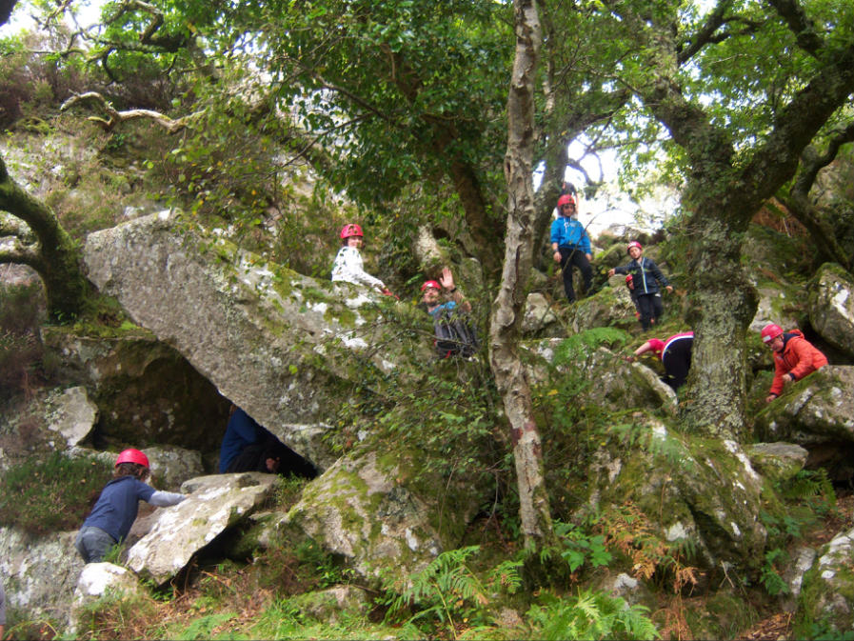
MORE THAN JUST AN ACTIVITY HOLIDAY
Independence
Working together with others
Achievement
Confidence and self-esteem
Personal organisation
Adventure and fun

Slide 7
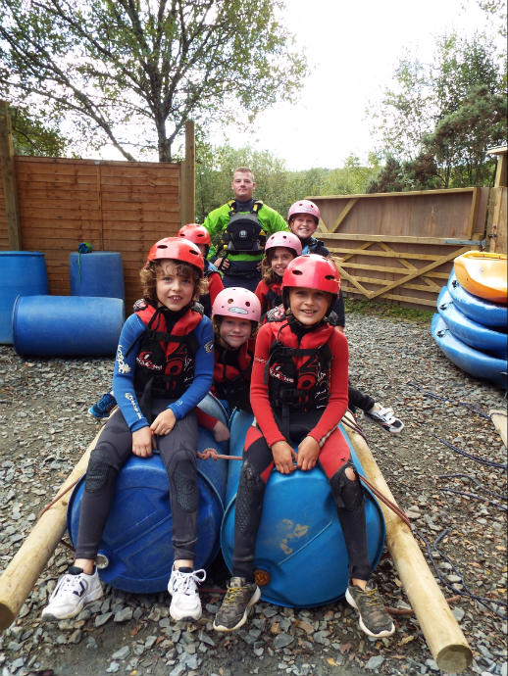
THE ACTIVITIES
Team challenges and problem solving tasks
Crate stack, Climbing wall & abseil tree
Water based activities such as canoeing, sit on top kayaks, paddle boarding & raft building
Gorge Scrambling, coasteering
Beach art, field archery & games
Range of evening activities including a
night walk, a disco and camp-fire fun

Slide 8
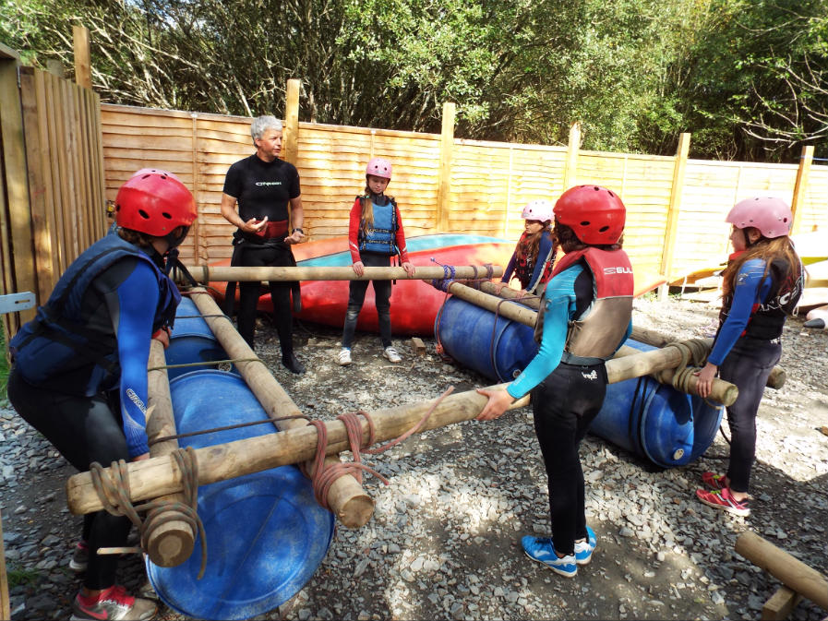

Slide 9
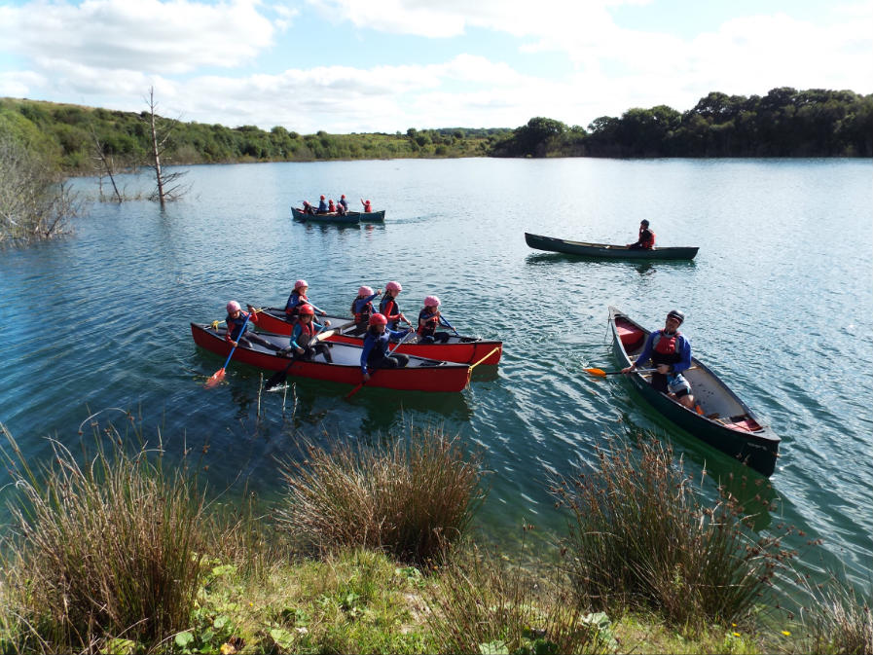

Slide 10
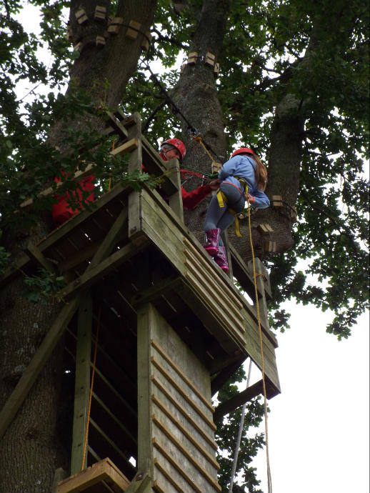
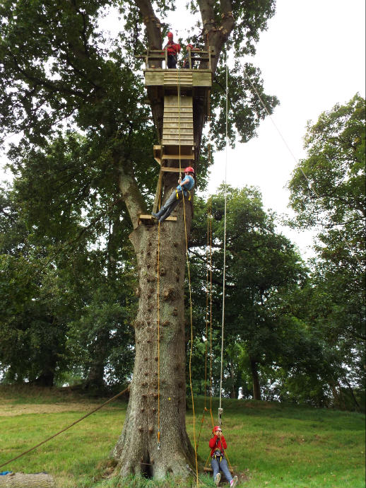

Slide 11
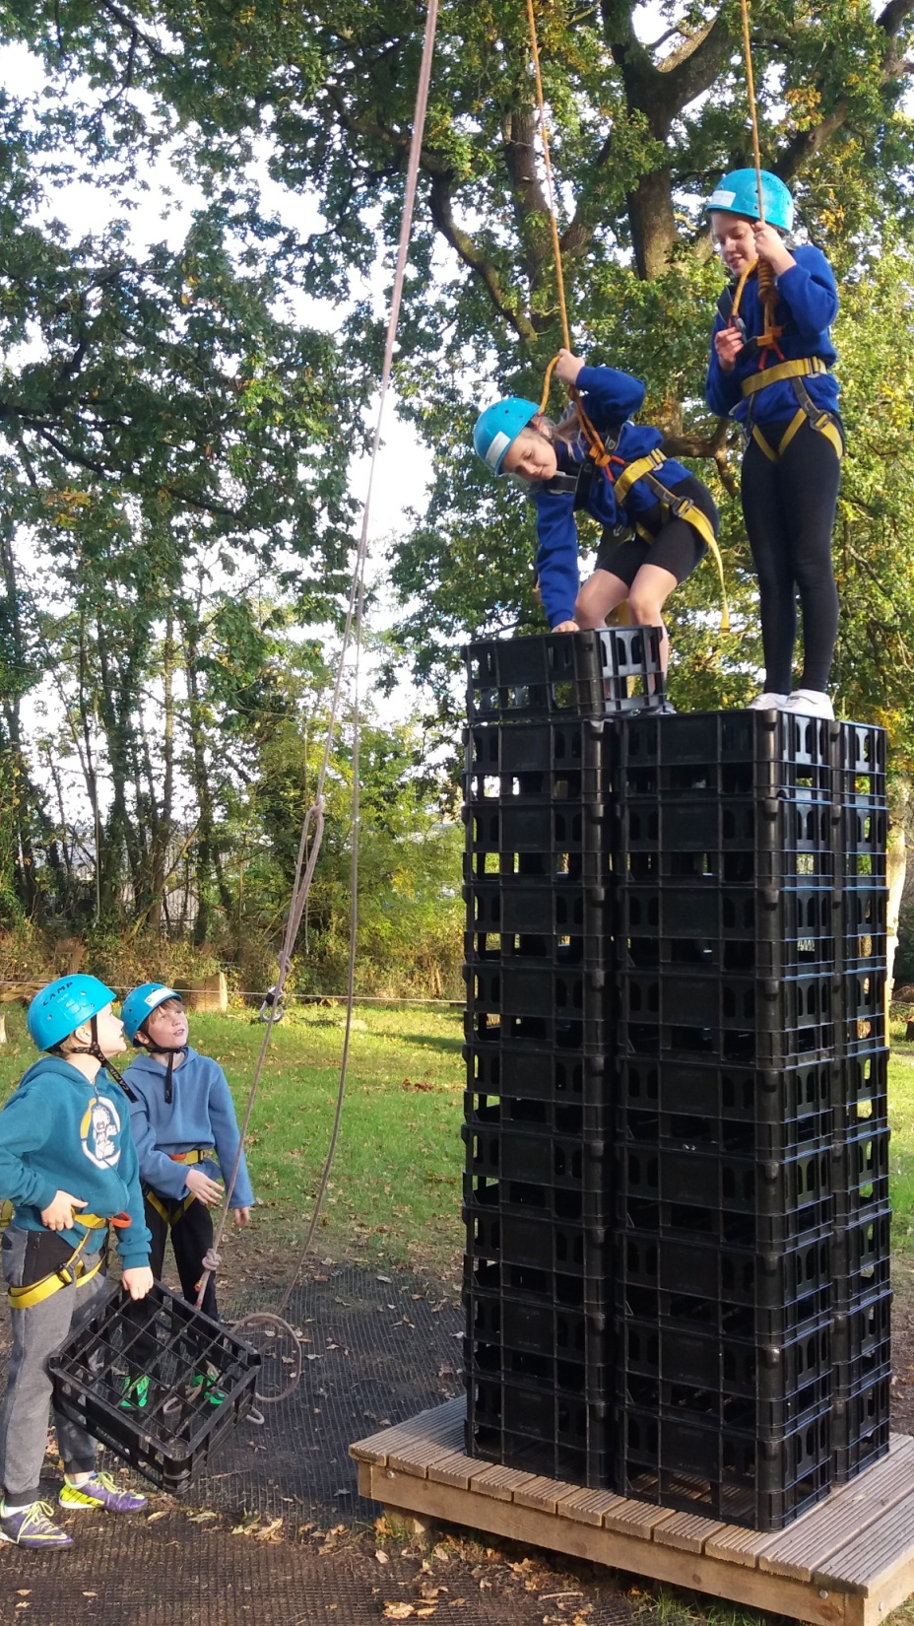

Slide 12
Extra information
The days will be jam packed - please make sure the children sleep well before sending them!
The food is nutritious and plentiful - we eat hearty, warming food and we enjoy lots of snacks and puddings!
Able to cater for all dietary requirements and allergies just let us know.
Children make their own packed lunch each day
School staff are supervising the children 24/7
Children choose a friend they would like to share a room with, school staff then organise sleeping arrangements to ensure your child’s happiness, best interests and safety, in single sex rooms

Slide 13
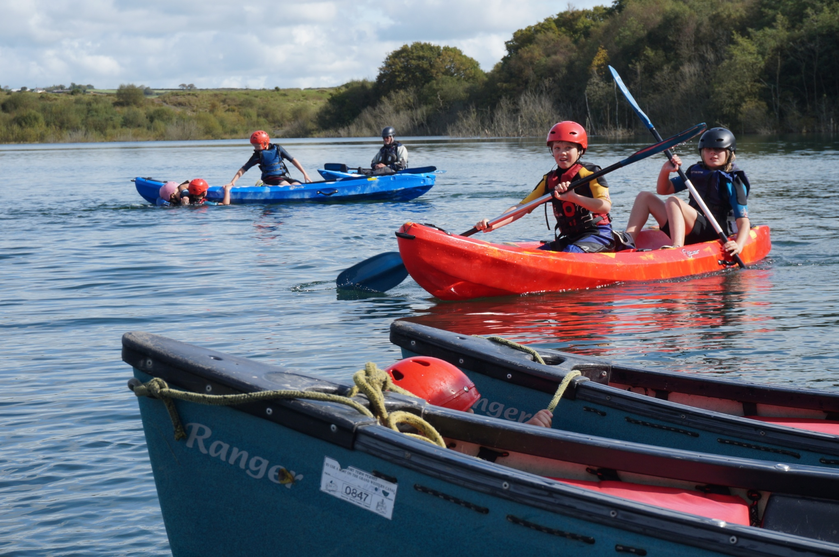

Slide 14
A Typical day
8.00 Breakfast
8.30 Make lunches
9.15 Meet for activities. Check all children have the right stuff
12.30 Lunch
1.15 Afternoon activities
4.30-5.00 finish day activities, shower, change
6.00 Dinner
7.15 – 8.30 Evening activity
8.30 Hot chocolate & biscuit & up to their rooms
9.30 Well earned sleep!

Slide 15
SAFETY
Safety is an attitude of mind, not just a set of rules.
Recognition of risk.
Qualified and experienced staff.
Appropriate equipment.
We provide outdoor safety training to others.
Inspected by British Activity Providers Association & Adventure Mark quality badge
School staff volunteer their time to supervise your children 24/7 and ensure they have the best time!

Slide 16
KIT LIST – MUST HAVES - A full list will come out once we have our full pupil lists - don’t buy new!
4 changes of warm clothes
Shorts
Swimming costume
Towel
Warm clothes
2/3 pairs trainers
Wellies
Disco outfit
Waterproof jacket and trousers (substantial)
Jacket
Torch
Spare batteries
Hat
Gloves
3 poly bin liners
Toilet kit
Night clothes
Water bottle
Rucksack
A cake to share

Slide 17
DON’T BRING/AVOID
Money
Jewellery
Computer games
Mobile phones – no individual communication from pupils. Staff will communicate a snapshot of the day via seesaw each evening
Massive suitcases - pack as ‘light’ as you can.
Sweets/extra food

Slide 18
Any Questions?
Now is the time!
Think of something at a later date?...
Ask your teachers or Mrs Oliver/Miss McDade

